Slide 1
Earth Alone
Red London Games
Commercial confidential
V1.1

Slide 2
Narrative
In 2086, the evacuation of the Earth was completed and the last spaceship carrying earth’s inhabitants left for Kepler 780 , its destination, and Earth’s new home
The meteor that was to strike the Earth was partially deflected at the eleventh hour by a salvo of nuclear missiles, and in the end only a chunk of the meteor hit the earth, avoiding its obliteration
You are one of the few thousands humans who, for one reason or another, decided not to board the last spaceship

Slide 3
Mission
You’re a scavenger and the abandoned Earth is your play field
You’re part of a clan and live in a hangout
An AI system called Two-2 detects when loots and supplies are located and sends you on missions to retrieve them, however other scavengers might get there first
Supplies and loot earned on a mission help you grow your clan
A mission lasts about 2.5 to 3 minutes

Slide 4
Mission Locations
At launch, there will be 7 locations. One for training and 6 others. More will be added later
The mission location is selected randomly on match start. This means that it’s unlikely that you will play the same location twice in a row
All missions occur in the South-West of the USA?
Within a location, there are variations:
The beginning tiles are identical but the end tiles are random
In some locations, it can rain
Some locations have a night and day version
The last tile is random: mission supplies can be found in an overturned truck, a boxcar, an abandoned hangar, a warehouse, etc.

Slide 5
Mission Arrival
All players arrive in the mission area in an exciting way
Either they arrive already running, or they zipline in, or their rappel down a helicopter, or they have just jumped off a cliff
Player control is given 3 seconds after the mission starts

Slide 6
Locations
Location | Description | Day or Night
Hyperloop Train track |  | Daytime
Plane cemetery
Sky City

Slide 7
Death & Respawn
If you die during the mission (ran into an obstacle, got struck by a lightning bolt, missed a turn, etc.), you will respawn in a safe location
Respawning makes you lose 3 seconds

Slide 8
Clan
The Earth has been abandoned for 2 years now and resources are becoming scarce
Clans compete for resources
Each clan has an emblem that represents them
When your clan hangout gets upgraded, there is a comic book cut-scene where you see the heroes build the upgrade in a quirky, fun way. For example Gin adding a satellite dish on the roof, Rug holding heavy 2 by 4s, heroes having a house warming party, etc.
You lose clan members if you lose too many missions in a row

Slide 9
Theme and heroes

Slide 10
Theme
You are on Earth
Heroes are much like the characters in the movie Guardians of the Galaxy: a bit rough around the edges, but ultimately likeable
The settings is inspired by games like Overwatch or Anthem

Slide 11
Art Style
Everything a bit bigger and chunkier than in reality
Simplified
Strong silhouettes
Striking poses
Vibrant color palette

Slide 12
Clans and hangout

Slide 13
Hangout
Your clan lives in an abandoned offshore oil rig
Every time you increase significantly your clan membership, your hangout looks nicer
Each hangout upgrade unlocks new cards
You can see the interior of your hangout in the background of the Main Menu
You can see the exterior of your hangout in the background of the Hero Selection menu

Slide 14
Heroes
Characters are heroic and have super-hero skills
They are over-the-top
They can be partially but not completely robots
They have their own unique personality, which is apparent in the model, animations, and voice overs
They have different ethnic backgrounds, body sizes and sexual orientation to show diversity

Slide 15
Heroes – Unique Power
Each hero has a unique power which reflects their personality
For example, Rug has Shockwave, Gin has Sentry, etc.
Each unique power has cool-down period of 30 seconds or so
Powers cannot be upgraded
Tap on the power icon below the turn-ribbon to activate the power

Slide 16
Heroes – Overview
There are initially 6 heroes to chose from. More will be added in updates
Heroes are balanced so that none of them are overpowered
There are no RPG mechanics for Heroes
You can select any hero before a mission in the Hero Selection menu

Slide 17
Heroes – Overview
All heroes are unlocked from the start
Heroes have voice lines
Heroes are members of a clan. The clan badge can be seen on the shoulder or back because the camera points at their back while running
Heroes have strong personalities. They are either funny, quirky or snarky. Listening to their voice lines is entertaining

Slide 18

Omni-tool
Each hero wears an arm-computer which is used to trigger defenses or attacks

Slide 19
Hero bios

Slide 20
Bit
Origin: French
Age: 18
Sex: female
Skill: Genius hacker. Can do anything with a computer
Power: Hack
Bit is famous for having hacked into Tetracorp and exposed the company for the environmental disaster they caused. She has quite the reputation among the Dark Internet community. She enjoys reading graphic novels. She never went to school. She is petite. She loves wearing fashion from the late 60s and early 70s.

Slide 21
Rug
Origin: American
Age: 26
Sex: Male
Skill: Strength
Power: Shockwave
He used to work as a docker. He is unbelievably powerful and strong. He’s addicted to tattoos. He has a number of piercings and chains as well. He’s as sweet as a Teddy Bear and wouldn't hurt a fly. He’s vegetarian. His mother passed away just before the last spaceship left.

Slide 22
Kä
Origin: Chinese
Age: 45
Sex: male
Skill: Explosives
Power: Homing Missile
Kä was abandoned when very young. He started to work at the Chelsea pyrotechnic company when he was just 13. He loves blowing things up with a flourish (he usually adds a firework to his C4). He lost a leg and a arm during an explosion while tinkering with home-made explosives while hammered. He wears bionic limbs. He has a fat belly because he loves dim sum so much.

Slide 23
Gin
Origin: Mexican
Age: 24
Sex: male
Skill: Robotics engineer
Power: Sentry
Gin is very shy and socially awkward. Feeling lonely, he created his first sentry so it would become his friend. Gin’s sentry is an expressive (think Wall-E) hovering robot that follows him around. He has a crush on Bit. Gin’s sentry can also fire missiles to protect Gin.

Slide 24
Hex
Origin: Afro-American
Age: 29
Sex: Male
Skill: Molecular
Power: Shrink
Hex is a molecular engineer. He graduated with top honours. He is into rap and loves to break dance. He wears a beanie hat. His shoes have fluorescent lights on them.

Slide 25
Firefly
Origin: Crazy Canuck
Age: 17
Sex: Male
Skill: Parkour
Power: Steal
Firefly is a bit of a kleptomaniac. When anything goes missing they blame him. He once paraglided down the tallest building in Toronto to impress a girl. He crashed and broke part of his skull. He now has a metal plate around part of his head. He did get the girl though. They dated for 3 years.

Slide 26
Sophia
Origin: Swedish
Age: 25
Sex: Female
Skill: Mystical elements. Too Magical?
Power: Lightning
She is a beautiful pagan hippie. She loves wearing flowers in her hair. She craves new age stuff and holding hands naked around a bonfire. Some call her wacky, but when you see her conjure fire out of thin air you are more likely to call her a witch. Others say that she can see the future and has visions of dark things to come. Because of this, she refuses to engage in any serious long-term relationship although she has many suitors. She likes Rug and they hang out a lot.

Slide 27
Brooke
Origin: Croatia
Age: 22
Sex: Female
Skill: Jack-of-all-trades
Power: Reflect
A newcomer to the clan. She just came in one day and dropped her torn backpack in the hangout. Nobody dared ask her to leave. She has a shaved head and Sanskrit tattoos. Brooke is dark and brooding. She has a criminal past and was behind bars for a long time. She is a survivor. She prefers being alone. She can understands the beeps of Gin's sentry and often talks with it, but about what, nobody knows. She is a bad apple. Why she hangs around with this clan is a mystery. She is petrified with fear on the zipline. Her tattoos are reprogrammable and change everyday

Slide 28
Hero Powers
Hero | Hero type | Power | Description | Charge time
Bit | Hacker | EMP wave |  | 60 sec
Rug | Tank | Shockwave |  | 60 sec
Kä | Explosives | Homing Missile |  | 60 sec
Gin | Engineer | Sentry |  | 60 sec
Hex | Molecular | Shrink |  | 60 sec
Firefly | Parkour | Double-jump |  | 60 sec
Sophia | Hippie | Chained Lightning/Hallucinations see pink rabbits |  | 60 sec
Brooke | Ex-Convict | Cloak |  | 60 sec
Notes:
See it as an Ultimate that you can use 1 or 2 per mission
Maybe charges faster if you are far behind
Radial time with %percengae

Slide 29
Cards

Slide 30
Blueprints
Each player has a collection of cards
A card can be activated during a mission by tapping on it in the turn-ribbon
Cards can be upgraded by collecting blueprints

Slide 31
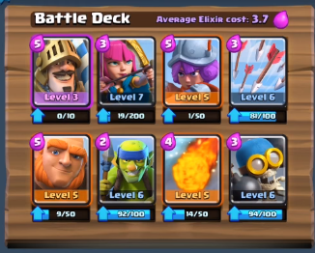
Card Deck – Overview
New players start with a deck of 8 cards
New cards can be purchased when on sale or found in loot boxes
A menu allows you to assemble your battle deck
It also displays your entire card collection including cards you haven’t found yet

Slide 32
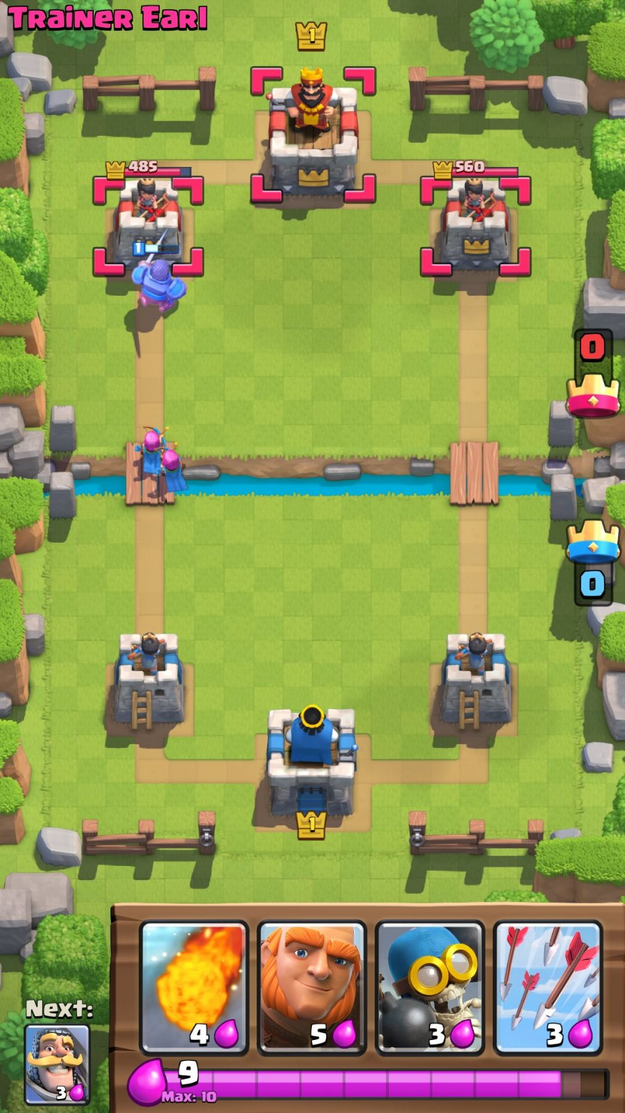
Cards – Turn ribbon
4 cards appear in a turn-ribbon on the side of the screen while on a mission
The next card to become available appears at the bottom of the turn-ribbon. It is smaller
Tap on a card to activate it
Each card cost power
Cards grey out if you don’t have enough power to activate them
Notes:
Maybe mention how the border of the card changes depending on the range of the enemy

Slide 33
Cards – Power bar
The power bar tells you how much power you have available to spend
Power replenishes over time
A mission starts with zero power to avoid having cards played in the first few seconds of gameplay

Slide 34
Cards at launch
24 cards will be available at launch. More will be added later
8 cards are immediately unlocked as part of the tutorial
New cards get unlocked every time the player hits a milestone in terms of clan size. More on that later

Slide 35
Cards 1/4
Card Name | Category | Rarity | Power Cost | Unlock Level
Lightning | Elemental | Epic | 5 | 0
Fire wall | Elemental | Rare | 3 | 0
Sprint | Endurance | Common | 2 | 0
Raging Bull | Endurance | Common | 3 | 0
Grenade | Explosive | Rare | 4 | 0
Stasis | Technology | Common | 6 | 0
Shrink | Molecular | Rare | 6 | 0
Double Jump | Endurance | Common | 1 | 0

Slide 36
Cards 2/4
Card Name | Category | Rarity | Power Cost | Unlock Level
Reflect | Hacking | Legendary | 7 | 0
Trip Mine | Explosive | Common | 3 | 0
Steal | Hacking | Rare | 3 | 0
Sentry | Technology | Rare | 7 | 0
Force Field | Technology | Rare | 3 | 0
Homing Missile | Explosive | Epic | 4 | 0
Jet Pack | Technology | Epic | 4 | 0
Linked Fate | Molecular | Epic | 5 | 0

Slide 37
Cards 3/4
Card Name | Category | Rarity | Power Cost | Unlock Level
Supercharger | Hacking | Epic | 4 | 0
Hack | Hacking | Legendary | 6 | Bit
Push | Technology | Rare | 3 | 0
Giant | Molecular | Epic | 6 | 0
Clone | Hacking | Rare | 3 | 0
Invisibility | Molecular | Legendary | 5 | 0
Purple Haze | Explosive | Common | 2 | 0
Headhunter | Explosive | Epic | 7 | 0
Notes:
Headhunter red crosshair on ground, 0.5 sec to counter with cloak or EMP, always targets 1st person, always works.
Hell storm large scale meteor strike Legendary 10 second 10 mana
Tar slows you down

Slide 38
Cards 4/4
Card Name | Category | Rarity | Power Cost | Unlock Level
Worm Hole | Hacking | Legendary | 4 | 0
Gravity Pull | Hacking | Common | 6 | Bit

Slide 39
Cards – Upgrading
Cards can be upgraded
Upgrading a Raging Bull card for example gives you the following benefits: longer duration and faster speed
Each upgrade cost coins
Each upgrade gives you XP
You need multiple blueprints of the same card to upgrade it. E.g.:
Upgrade Sentry from level 1 to 2 requires 10 blueprints
Upgrade Sentry from level 2 to 3 requires 25 blueprints

Slide 40
Cards – Ranking
There are 4 types of cards:
Common cards have 13 different levels
Rare cards have 11 different levels
Epic cards have 8 different levels
Legendary cards have 5 different levels
Legendary cards have special animations on them

Slide 41
Duplicate Cards
Duplicate cards over the maximum useful number will be converted into coins automatically
Every Common over the maximum gives 5 coins
Every Rare over the maximum gives 50 coins
Every Epic over the maximum gives 1000 coins
Every Legendary over the maximum gives 20,000 coins

Slide 42
Level Up
When you earn enough XP, you level up
There are 100 levels
Any of these actions grants XP:
Finishing a mission (250 xp)
Doing a consecutive race (race needs to start within one minute of the last race finish) (200 xp)
Winning a mission (500xp)
First win of the day (1500xp)
Upgrading a card. The XP awarded increases with the card level and rarity. Upgrading a common card from level 2 to 3 gives you 5xp whereas upgrading a legendary card from level 4 to 5 gives you 3,200xp

Slide 43
Level Up Rewards
One loot box
A new frame for your hero icon every 10 levels

Slide 44
Competitive Seasons
To be discussed

Slide 45
Progression System
Non-competitive
Increase your clan size
Competitive
Increase your ranking: Bronze, Silver, etc.
It also affects your clan size
You need to be level 25 to join in competitive play

Slide 46
Player matching
Players of similar skill and experience are matched together based on their rank and Elo rating

Slide 47
Player ranks
A new player starts with Recruit rank.
After completing training, the player becomes rank: Bronze
There are 6 ranks in all:
Bronze, Silver, Gold, Master, Grandmaster and Champion

Slide 48
Game modes
You can play both online and offline

Slide 49
Online game modes
Quick Play
matches you against 1, 2 or 3 players of similar skill level
Missions with more players allow you to earn more coins
Play with friend
Allows you to play with one friend. You need to know the friend’s user name to invite him or her
Weekly Leaderboard Tournament
Accumulate the most wins in a week to win amazing loot boxes

Slide 50
Offline mode
You can play offline either alone or in PvE against 2 or 3 bots
You do not earn trophies
You earn coin, but less than in an online match
You earn the normal amount of XP
You choose the mission location

Slide 51
Loot Boxes – Overview
You get a loot box:
Every time you level up
When you have earned 10 crowns through racing
You can buy loot boxes in the store

Slide 52
Loot Box Content
Coins
Gems (not all loot boxes gives gems)
Cards
New hero skins. They have a rarity (Common, Rare, Epic, Legendary)
Player Icons
Taunt voice lines

Slide 53
Store
You can buy:
Gems using $
Coins using gems
Loot boxes using gems
Cards using coins
Notes:
Replace gem

Slide 54
Video recording and streaming
You can record and share videos of your missions
You can also stream videos of your mission to Mobcrush for example
The video recording uses the iOS Replay Kit and is not available for Android

Slide 55
Social Media
You can invite friends to play if they are online
You have a list of friends
You can also see a list of the most recent players you played against and add them as friends if you want
You can Invite Facebook friends to install the app

Slide 56
Game Center
The game supports a number of achievements

Slide 57
Career Profile
You can look at your performance in Career Profile
It lists a number of cool statistics such as:
Win/loss ratio
Best win streak
Favourite Card
Etc.

Slide 58
Daily reward
You get a free loot box every 4 hours
You can stack up to two loot boxes

Slide 59
Player Needs

Slide 60
As a player, I want …
Every mission to feel different
To leverage the environment to my advantage and feel clever
To feel I always have a chance to catch-up
To feel cool and powerful
The right information to play the right card
I want to pass players in the level

Slide 61
As a player, I want …
To be rewarded and celebrated if I win
To be able to share my victories and best missions

